Slide 1
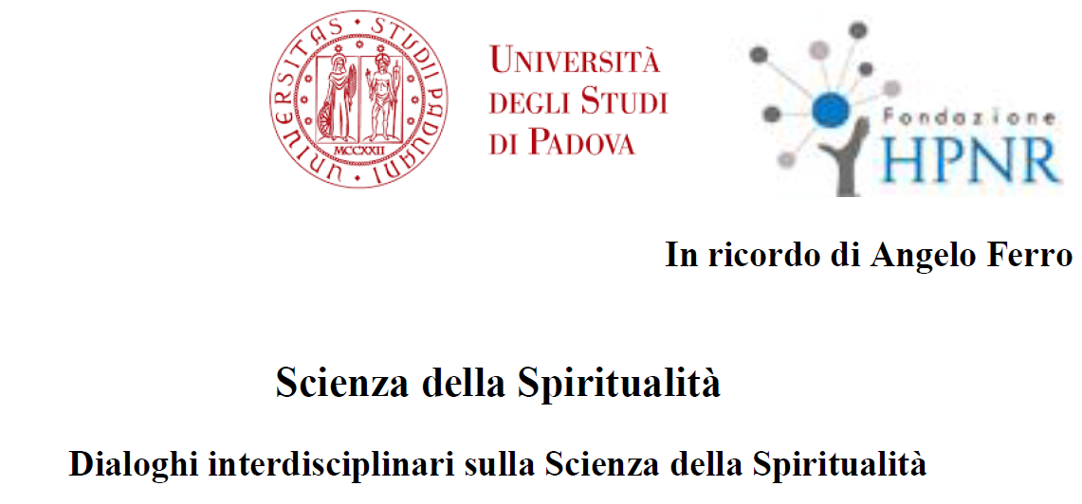
Economia e spiritualità
Benedetto Gui
Istituto Universitario Sophia
Palazzo del Bò, 10 maggio 2016

Slide 2
Due mondi che non si toccano?
“…the two great forming agencies of the world's history have been the religious and the economic. …
Religious motives are more intense than economic, but their direct action seldom extends over so large a part of life.
For the business by which a person earns his livelihood generally fills his thoughts during by far the greater part of those hours in which his mind is at its best; during them his character is being formed by the way in which he uses his faculties in his work, by the thoughts and the feelings which it suggests, and by his relations to his associates in work, his employers or his employees.
Alfred Marshall, Principles of Economics, 1890)

Slide 3
As we get rich, the basics of life … become a very small part of total expenditure.
And people have enough money to purchase things that enhance them spiritually and I mean the word spiritual not necessarily in a religious sense but in the sense that it adds to your feeling of well-being.
Robert Fogel "Early Retirees Turn to Volunteer Work," 2005

Slide 4
Spiritualità
sostantivo femminile 1 l'essere spirituale 2 tendenza a sentire i valori spirituali, ad avere sentimenti nobili ed elevati; religiosità
(Dizionario Il Corriere online)
Simile il Palazzi - Folena

Slide 5
Perché questi due mondi non si toccherebbero?
Tradizionalmente la scienza economica si è concentrata su:
individuo autonomo (tipica interazione lo scambio)
con obiettivi «materiali» (i beni economici)
razionale (unica facoltà considerata)
con approccio «strumentale» (unica logica considerata)
applicato a giochi in cui funziona bene (mercato)
Il cosiddetto «homo oeconomicus» ha già in sé il suo sistema di preferenze ed entra in rapporti contrattuali con gli altri per soddisfarle al meglio.
Con gli altri contratta.
Non ha una dimensione interiore, o comunque non conta

Slide 6
Le eccezioni confermano…
Antonio Genovesi
Sismonde de Sismondi
John Hobson
…
Ma Philip Wicksteed, pastore e teologo oltre che economista, propose il «non-tuismo»

Slide 7
Le cose stanno cambiando
«Preferenze sociali» (altruismo, avversione alla disuguaglianza,…)
Un caso particolare, la reciprocità
Motivazioni intrinseche
Non-market interactions
Un caso particolare, i «beni relazionali»
Si può parlare di «svolta comportamentale» nella scienza economica
Di una «svolta relazionale» non ancora, ma quasi

Slide 8
Caduto il modello semplificato di scelta razionale, ora c’è spazio per tante cose
Sentimenti
Disposizioni
Norme sociali
Confronti con altri
Orientamenti culturali
Convinzioni religiose
Appartenenze religiose e non (social capital)

Slide 9
Con conseguenze su
Scelte lavorative
Reddito guadagnato
Scelte di consumo
Scelte di risparmio
Atteggiamento verso il rischio
Restituzione dei prestiti
Contribuzione volontaria ai beni pubblici
Imprenditorialità…

Slide 10
Modeling Religious Behavior and Economic Outcome: Is the Relationship Bicausal?
Author: Arano, Kathleen G.; Blair, Benjamin F. Source: Journal of Socio-Economics, October 2008, v. 37, iss. 5, pp. 2043-53 Abstract: This paper examines simultaneity between religious intensity and income. Most of the literature to date has examined either the impact of religion on economic outcomes or the impact of economic outcomes on religious activities. Our estimation offers evidence of a bicausal relationship. We find frequency of attendance to religious services is a normal good; low-income households are less likely to be active in religious activities; and low-religious intensity households are less likely to be in the high-income category.

Slide 11
(When) Are Religious People Nicer? Religious Salience and the 'Sunday Effect' on Pro-social Behavior
Author: Malhotra, Deepak Author Affiliation: Harvard U Source: Judgment and Decision Making, April 2010, v. 5, iss. 2, pp. 138-43 Abstract: Prior research has found mixed evidence for the long-theorized link between religiosity and pro-social behavior. To help overcome this divergence, I hypothesize that pro-social behavior is linked not to religiosity per se, but rather to the salience of religion and religious norms. I report a field experiment that examined when auction participants will respond to an appeal to continue bidding for secular charitable causes. Religious individuals are more likely than non-religious individuals to respond to an appeal "for charity" only on days that they visit their place of worship; on other days of the week, religiosity has no effect. Notably, the result persists after controlling for a host of factors that may influence bidding, but disappears when the appeal "for charity" is replaced by an appeal to bid for other (i.e., competitive) reasons. Implications for the link between religion and pro-social behavior are discussed.

Slide 12
Household Repayment Behavior: The Role of Social Capital and Institutional, Political, and Religious Beliefs
Author: Georgarakos, Dimitris; Furth, Sven Source: European Journal of Political Economy, March 2015, v. 37, pp. 249-65 Abstract: We examine the influence of social capital and various prevailing beliefs on household repayment behavior in Europe, after accounting for household-specific characteristics and country differences in institutions. Arrears are more common among households living in regions with dense corruption beliefs, low confidence in institutions and authorities, and a low fraction of religious people. Moreover, high stocks of social capital reduce the likelihood of arrears, net of the influence of various potentially relevant factors. Households in these communities face a higher hazard of losing standing in the group and access to the positive externalities of social capital.

Slide 13
A Tale of Minorities: Evidence on Religious Ethics and Entrepreneurship
Author: Nunziata, Luca; Rocco, Lorenzo Author Affiliation: U Padua and IZA, Bonn; U Padua Source: Journal of Economic Growth, June 2016, v. 21, iss. 2, pp. 189-224 Abstract: Does Protestantism favour entrepreneurship more than Catholicism does? We provide a novel way to answer this question by comparing Protestant and Catholic minorities using Swiss census data. Exploiting the strong adhesion of religious minorities to their denomination' ethical principles and the historical determination of the geographical distribution of denominations across Swiss cantons, we find that Protestantism is associated with a significantly higher propensity for entrepreneurship. The estimated difference ranges between 1.5 and 3.2% points, it is larger the smaller the size of the religious minority, it is mainly driven by prime age male entrepreneurs and it stands up to a number of robustness checks. No effects are found when comparing religious majorities, suggesting that the implications of religious ethical norms on economic outcomes emerge only when such norms are fully internalized.

Slide 14
La letteratura su economia e felicità
Attingendo a grandi database da questionari si indagano le determinanti del benessere soggettivo:
Il reddito (o la spesa per consumi) conta poco
Il reddito altrui conta (al contrario)
La salute conta
Le relazioni interpersonali contano
La religione conta

Slide 15
Exploring Factors Affecting the Level of Happiness across Countries: A Conditional Robust Nonparametric Frontier Analysis
Author: Cordero, Jose Manuel; Salinas-Jimenez, Javier; Salinas-Jimenez, M Mar Source: European Journal of Operational Research, January 2017, v. 256, iss. 2, pp. 663-72 Abstract: In this paper we propose an innovative approach based on life satisfaction to estimate efficiency measures for individuals considering how they convert their resources into higher levels of happiness. We use an extension of the conditional nonparametric robust approach which allows us to consider a mixed set of contextual variables that can affect the levels of life satisfaction. Our empirical analysis includes data about 31,854 individuals from 26 OECD countries participating in the last wave of the World Values Survey. Results obtained indicate that the most efficient individuals in achieving happiness tend to live in northern and central European countries whereas the less efficient individuals are found, in average, in Asian transitional economies. In addition, it is also found that most of the traditional determinants of wellbeing (e.g. age, marital status, religion or unemployment) also have a significant impact on efficiency measures.

Slide 16
The Direct and Indirect Impact of Religion on Well-Being in Germany
Author: Groezinger, Gerd; Matiaske, Wenzel Source: Social Indicators Research, April 2014, v. 116, iss. 2, pp. 373-87 Abstract: A European Social Survey (ESS)--based study of Clark and Lelkes on the European level showed a double positive connection between religion and life-satisfaction: not only did a personal involvement have a positive impact, but there was also a regional externality. Even atheists seemed to be happier in areas with many religious people. However, the regional structure of the ESS can be seen as methodologically doubtful. We therefore replicated the study with more rich German data. In our study, we confirm the positive individual effect of religion, but we did find a negative regional externality. However, further analysis revealed, this was an effect of an omitted variable: the degree of urbanization. In a more detailed approach we show that this effect is confined to areas with a protestant majority. We conclude that the positive degree of urbanization influence on life-satisfaction is presumably due to the chance for more political participation in the (protestant) city states in Germany.

Slide 17
Religious Attendance, Stress, and Happiness in South Korea: Do Gender and Religious Affiliation Matter?
Author: Jung, Jong Hyun Source: Social Indicators Research, September 2014, v. 118, iss. 3, pp. 1125-45 Abstract: Is religious attendance positively associated with happiness in South Korea? If yes, can religious attendance buffer against the harmful effect of stress on happiness? Moreover, do gender and religious affiliation modify these associations? This study addresses these questions with data from 2009 Korean General Social Survey which is a nationally representative survey (N = 1,599). Ordinal least square regression analyses reveal that although the effect size is relatively small, religious attendance is associated with a higher level of happiness in South Korea. However, this positive effect holds only for women and only for Protestants. In addition, an interaction effect between religious attendance and stress is observed for women only; the negative association between stress and happiness is weakened among those women who report more frequent church attendance. In this regard, a high level of church attendance buffers against the deleterious effects of stress on happiness for women. I discuss the implications of the findings with regard to theories about religion, mental health, and gender in South Korean context.

Slide 18
Beni relazionali (1)
Sono entità immateriali:
generate dalle interazioni personalizzate tra due o più persone;
ii) che hanno un valore per le persone coinvolte
- o perché sono "consumate" nel corso dell'interazione stessa (ad esempio la cordialità della comunicazione tra parrucchiera e cliente o dello scambio di battute tra due colleghi che si incontrano brevemente nel corridoio)
- o perché consentono loro di ottenere migliori outcome dalle loro interazioni (un esempio è lo specifico gergo sviluppato da un team di tecnici impegnati in un progetto di ricerca e sviluppo; un altro è la confidenza esistente tra un paziente e un medico)

Slide 19
Beni relazionali (2)
Qui entrano in gioco:
particolari competenze (relational skills)
gratuità (se i due non riescono a distaccarsi un po’ dai propri interessi o obiettivi non c’è una vera relazione interpersonale)
la convinzione che la «comunione» è preziosa e per essa merita pagare un costo
Qui entrano in gioco convinzioni religiose, o per lo meno il loro «precipitato culturale»
Economia e «carismi», religiosi certamente, ma non solo (Bruni-Smerilli, Benedetta economia)

Slide 20
Economia e «carismi»
«…con “carisma” intenderemo un dono di occhi capaci di vedere cose che gli altri (che non hanno quel carisma o che non ne partecipano) non vedono» (Bruni-Smerilli, Benedetta economia)
Carismi religiosi, ma non necessariamente
Il «carisma dell’unità» di Chiara Lubich, che mi coinvolge personalmente
Il dolore (in tutti i sensi) accettato per e trasformato dall’amore
Con l’effetto di creare sorprendentemente «comunione»:
nei rapporti familiari
in ambito pedagogico
in ambito politico
in ambito interreligioso (lei fondatrice di un movimento della chiesa cattolica, con cristiani di altre denominazioni, con credenti di altre religioni
Proponendo e vivendo un’esperienza di «comunione dei beni

Slide 21
Economia di Comunione
Di fronte a povertà e disuguaglianza, l’invito a fare economia, fare impresa, per riavvicinare (San Paolo del Brasile, 1991)
Condividere gli utili (tre «terzi»)
Ma poi:
trasformare rapporti economici in rapporti pienamente umani
includere soggetti svantaggiati
E in tutto ciò, muoversi nella prospettiva della comunione

Slide 22
Esempi
Il lavoratore licenziato e ripreso
L’aiuto al concorrente
Come fare con il lavoratore che si droga
Per non pagare tangenti perdere una commessa tutta da perdere
Il cliente che continua a «rompere»
Microcredito ante litteram nelle Filippine
Dire di no ad un cliente e vederlo ritornare perché si fida
Lasciare un’offerta nella Cina in boom per andare a far tutto da zero in un Brasile ancora arretrato
Come comportarsi con il concorrente che ti calunnia
Imprenditori «gioiosi»
http://collegamentoch.focolare.org/2014/06/16/outside-the-box/
www.edc-online.org

Slide 23
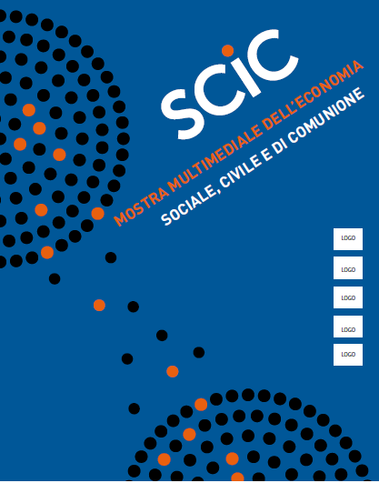
Mi sia consentita un po’ di
«Pubblicità progresso»

Slide 24
3 corsi di laurea magistrale
economico-politico, filosofico-teologico,
interdisciplinare (cultura dell’unità)

Slide 26
“ if we examine the entire history of mankind, more people have died on account of religion than on account of the stock market” (Iyer, The New Economics of Religion, 2016, p. 435)

